Slide 1
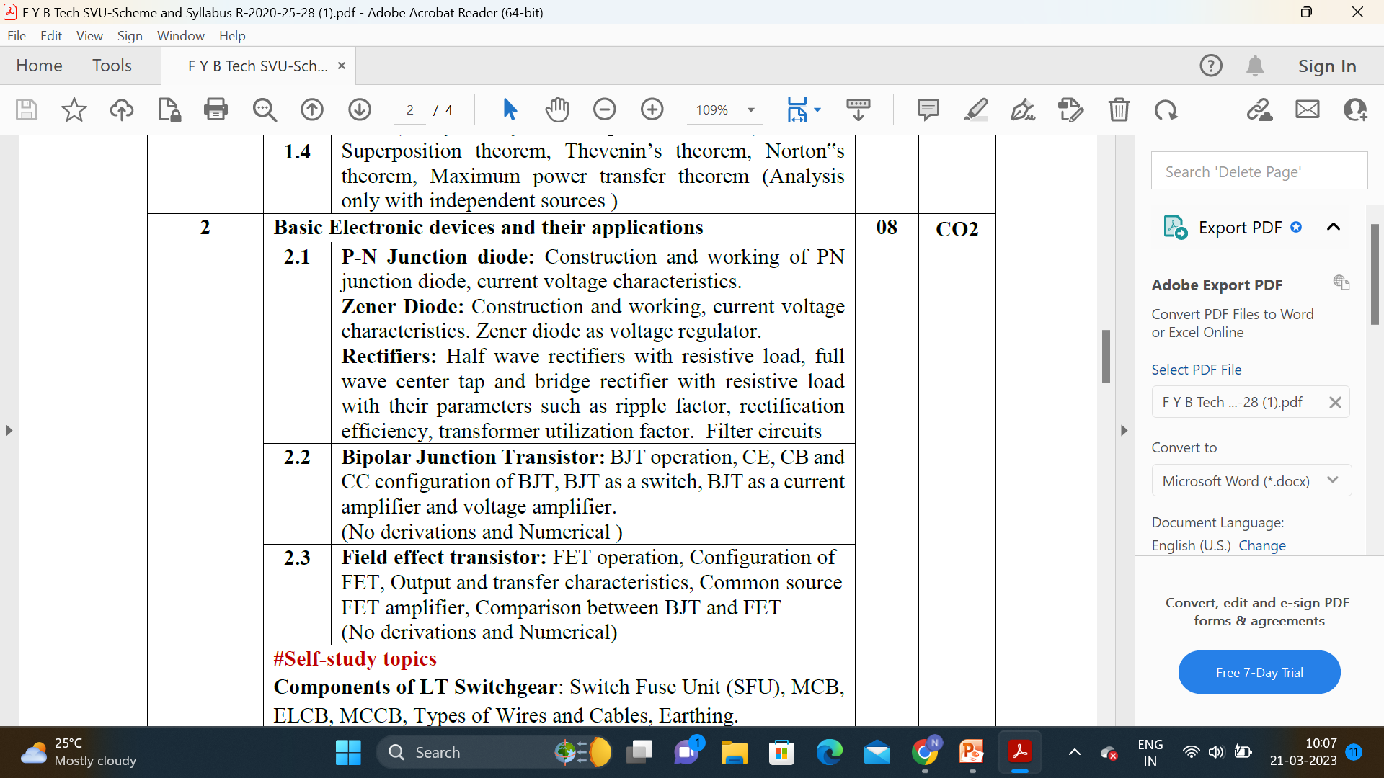
Module 2 Basic Electronic devices and their applications
Dr. Neethu Anna Sabu
AP/EXTC

Slide 2
P-N Junction diode and Zener Diode
Introduction to Semiconductors
PN Junction
PN Junction Diode
→ Construction
→ Thermal Equilibrium
IV characteristics of PN Junction Diode
→ Forward Bias , Zero bias
→ Reverse Bias
Avalanche Breakdown 2. Zener Breakdown
Zener Diode
IV characteristics of Zener Diode
Zener Diode as Voltage Regulator
Rectifier & Filter -Check scanned document for TUF (FWR)

Slide 3
Classification of Materials
→ Based on Electrical Conductivity
Parameter | Conductor (e.g. Copper, Aluminium, Silver, Gold) | Semiconductor e.g. Germanium, Silicon GaAs | Insulators e.g. Paper, Mica, glass, quartz
Resistivity | 10⁻⁴ to 10⁻⁶ Ω-cm. | 10¹ to 10⁴ Ω-cm. | 10¹⁰ to 10¹² Ω-cm.

Slide 4
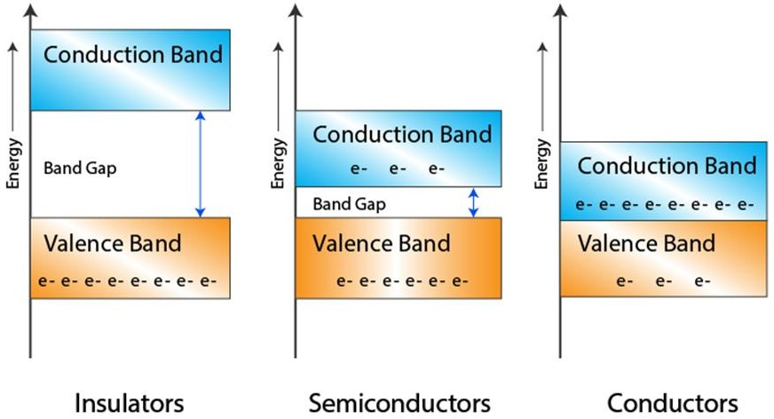
Classification of Materials..
→ Energy band diagrams insulator, semiconductor and conductor
Band structure of a material defines the band of energy levels that an electron can occupy.
≈6eV
≈1.1eV
The electrons in the outermost shell are known as valence electrons.
These valence electrons contain a series of energy levels and form an energy band known as valence band. The valence band has the highest occupied energy.
The valence electrons can leave the outermost orbit even at room temperature and become free electrons. The free electrons conduct current in conductors and are therefore known as conduction electrons.
The conduction band is one that contains conduction electrons and has the lowest
occupied energy levels.
The gap between the valence band and the conduction band is referred to as forbidden gap. As the name suggests, the forbidden gap doesn’t have any energy and no electrons stay in this band.

Slide 5
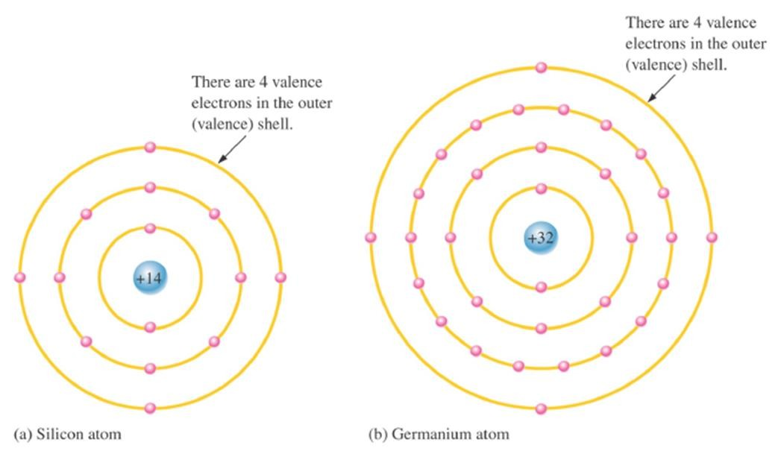
Semiconductor Materials
Two types of semiconducting materials : silicon and germanium
→both have four valance electrons
→ atoms within the crystal structure are held together by covalent bonds (atoms share valence electrons)
→An intrinsic crystal is one that has no impurities

Slide 6
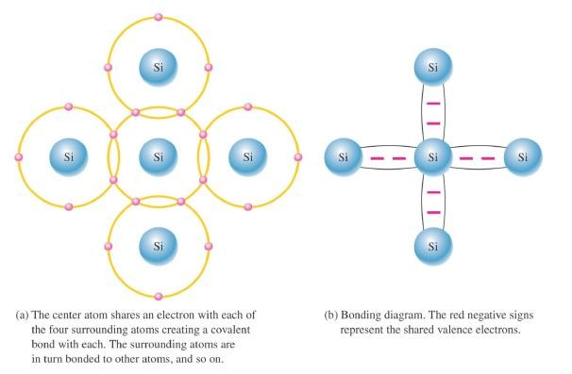
Semiconductor Materials..
Covalent bonds in a silicon crystal. The actual crystal is 3-dimensional.

Slide 7
Modified Semiconductor Materials
Introduction to Semiconductor Materials..
Conductivity of semi-conductors can be improved by replacing/adding certain donor/acceptor atoms-producing more free electrons than holes or vice versa.
Doping is the process of adding impurities to intrinsic semiconducting materials to increase and control conductivity within the material.
→ n-type material is formed by adding pentavalent (5 valence electrons) impurity atoms to the crystalline structure of Si (Pentavalent impurities : Phosphorous , Arsenic, Antimony)-DONORS (as each impurity atom donates one electron)
-- electrons are called majority carriers in n-type material
-- holes are called minority carriers in n-type material
→ p-type material is formed by adding trivalent (3 valence electrons) impurity atoms to the crystalline structure of Si (Tri-valent impurities : Boron (B), Gallium (G), Indium(In), Aluminium(Al))-ACCEPTORS (as each impurity atom generates one electron)
-- holes are called majority carriers in p-type material
-- electrons are called minority carriers in p-type material

Slide 8
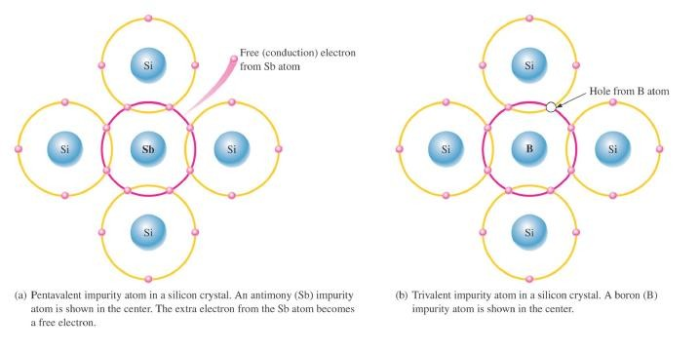
Introduction to Semiconductor Materials..
Modified Semiconductor Materials

Slide 9
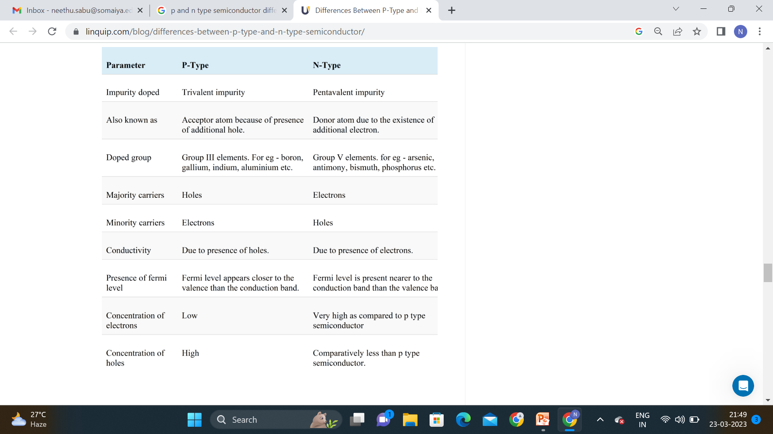

Slide 10
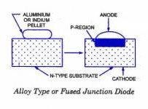
P-N Junction
A p-n junction is formed by joining p-type and n-type semiconductors together in very close contact. The term junction refers to the boundary interface where the two regions of the semiconductor meet.
p-n junctions are created in a single crystal of semiconductor by doping, for example, by ion implantation, diffusion of dopants, or by epitaxy (growing a layer of crystal doped with one type of dopant on top of a layer of crystal doped with another type of dopant)
p-n junctions are elementary “building blocks” of almost all semiconductor electronic devices such as diodes, transistors, solar cells, LEDs, and integrated circuits; they are the active sites where the electronic action of the device takes place.

Slide 11
P-N junction formation
When the N-type semiconductor and P-type semiconductor materials are first joined together a very large density gradient exists between both sides of the PN junction.
The result is that some of the free electrons from the donor impurity atoms begin to migrate across this newly formed junction to fill up the holes in the P-type material producing negative ions.
because the electrons have moved across the PN junction from the N-type silicon to the P-type silicon, they leave behind positively charged donor ions ( N_{D} ) on the negative side and now the holes from the acceptor impurity migrate across the junction in the opposite direction into the region where there are large numbers of free electrons.
the charge density of the P-type along the junction is filled with negatively charged acceptor ions ( N_{A} ), and the charge density of the N-type along the junction becomes positive. This charge transfer of electrons and holes across the PN junction is known as diffusion.

Slide 12
This process continues back and forth until the number of electrons which have crossed the junction have a large enough electrical charge to repel or prevent any more charge carriers from crossing over the junction.
Eventually a state of equilibrium (electrically neutral situation) will occur producing a “potential barrier” zone around the area of the junction as the donor atoms repel the holes and the acceptor atoms repel the electrons.
Since no free charge carriers can rest in a position where there is a potential barrier, the regions on either sides of the junction now become completely depleted of any more free carriers in comparison to the N and P type materials further away from the junction. This area around the PN Junction is now called the Depletion Layer.
Depletion region or depletion layer is a region in a P-N junction diode where no mobile charge carriers are present. Depletion layer acts like a barrier that opposes the flow of electrons from n-side and holes from p-side.

Slide 13
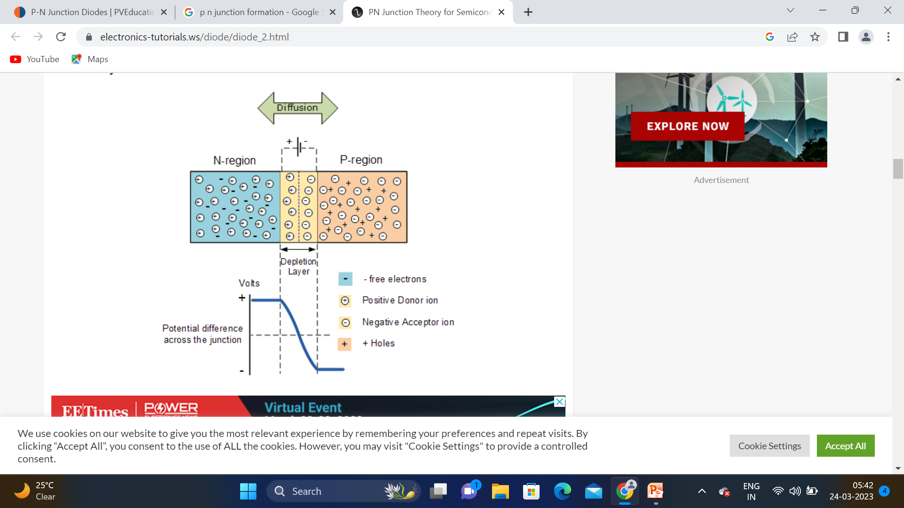

Slide 14
P N junction formation-summary
Joining n-type material with p-type material causes excess electrons in the n-type material to diffuse to the p-type side and excess holes from the p-type material to diffuse to the n-type side.
Movement of electrons to the p-type side exposes positive ion cores in the n-type side while movement of holes to the n-type side exposes negative ion cores in the p-type side, resulting in an electron field at the junction and forming the depletion region.
On the n-type side, positive ion cores are exposed. On the p-type side, negative ion cores are exposed.
An electric field E forms between the positive ion cores in the n-type material and negative ion cores in the p-type material. This region is called the "depletion region" since the electric field quickly sweeps free carriers out, hence the region is depleted of free carriers.
A "built-in" potential is formed at the junction due to electric field

Slide 15
https://www.pveducation.org/pvcdrom/pn-junctions/formation-of-a-pn-junction

Slide 16
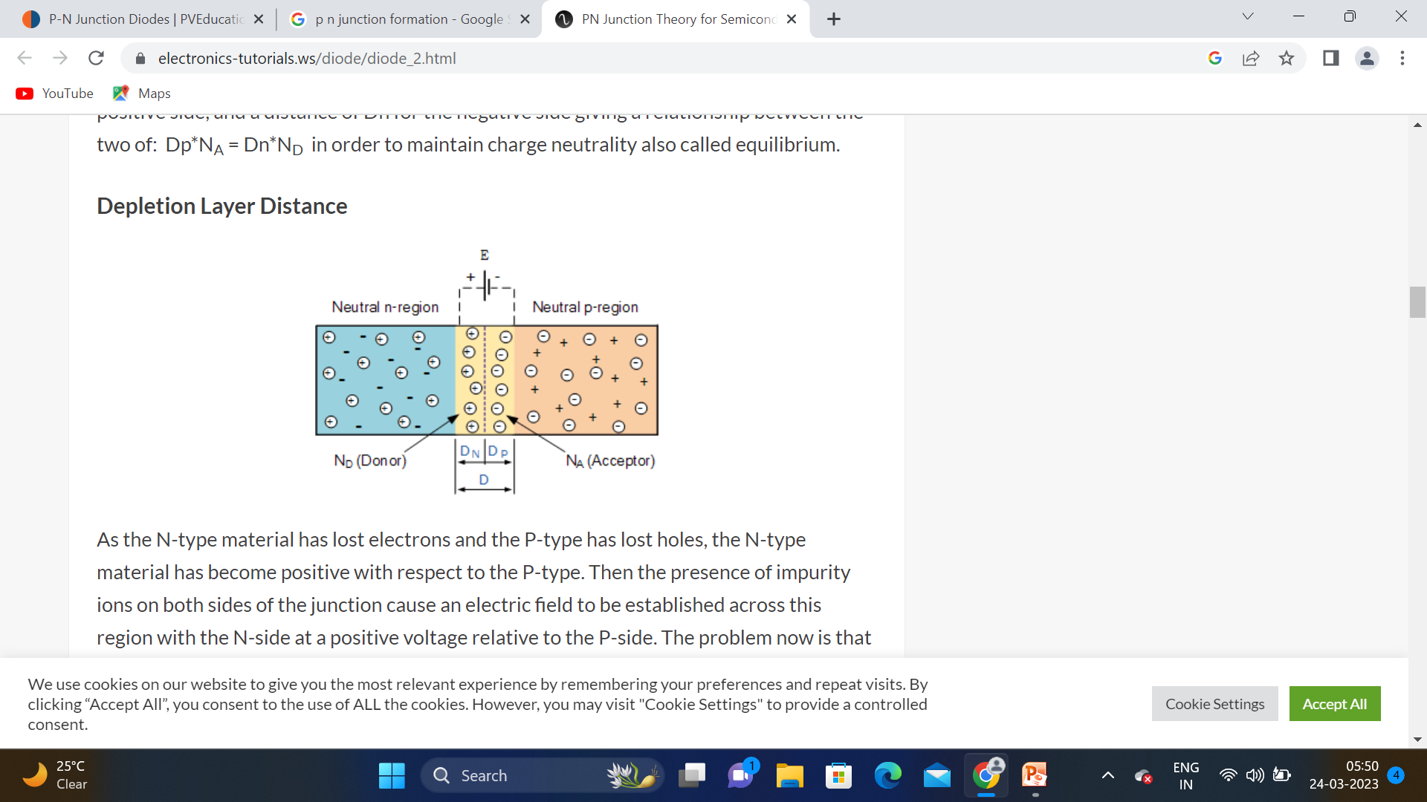
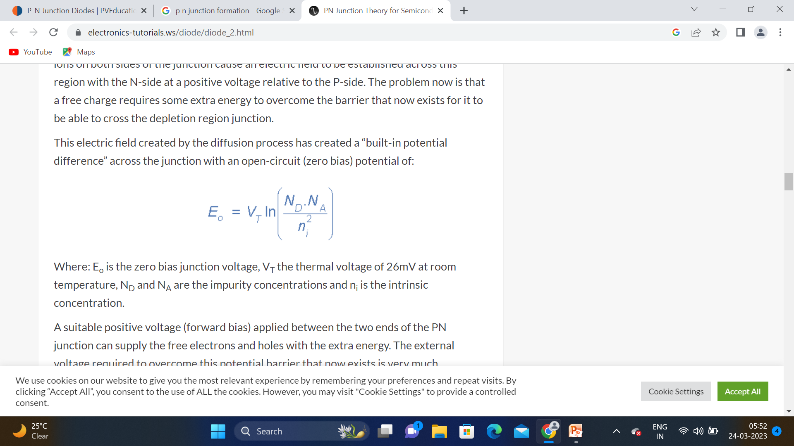

Slide 17
P N junction diode
A PN Junction Diode is one of the simplest semiconductor devices around, and which has the electrical characteristic of passing current through itself in one direction only.
it has an exponential current-voltage ( I-V ) relationship and therefore we can not described its operation by simply using an equation such as Ohm’s law.
If a suitable positive voltage (forward bias) is applied between the two ends of the PN junction, it can supply free electrons and holes with the extra energy they require to cross the junction as the width of the depletion layer around the PN junction is decreased.
By applying a negative voltage (reverse bias) results in the free charges being pulled away from the junction resulting in the depletion layer width being increased.
This has the effect of increasing or decreasing the effective resistance of the junction itself allowing or blocking the flow of current through the diodes pn-junction.

Slide 18
Then the depletion layer widens with an increase in the application of a reverse voltage and narrows with an increase in the application of a forward voltage.

Slide 19
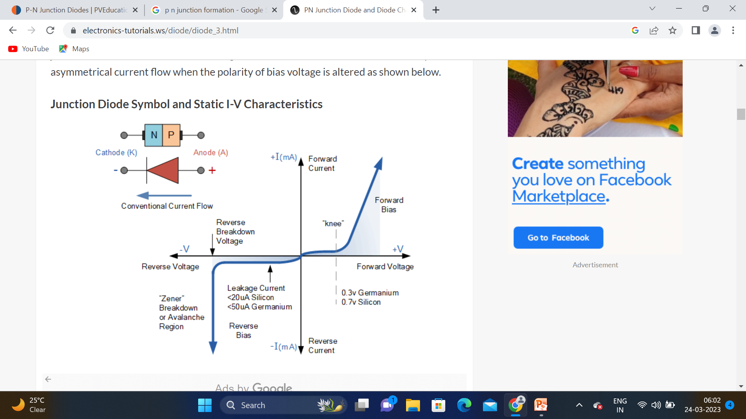

Slide 20
But before we can use the PN junction as a practical device or as a rectifying device we need to firstly bias the junction, that is connect a voltage potential across it
There are two operating regions and three possible “biasing” conditions for the standard Junction Diode and these are:
1. Zero Bias – No external voltage potential is applied to the PN junction diode.
2. Reverse Bias – The voltage potential is connected negative, (-ve) to the P-type material and positive, (+ve) to the N-type material across the diode which has the effect of Increasing the PN junction diode’s width.
3. Forward Bias – The voltage potential is connected positive, (+ve) to the P-type material and negative, (-ve) to the N-type material across the diode which has the effect of Decreasing the PN junction diodes width.

Slide 21
Zero Biased Junction Diode
no external potential energy is applied to the PN junction
Zero bias is the condition of thermal equilibrium where the number of charge carriers on both the ends is balanced.
As there is no external power supply to the diode the electrons diffuse towards p-side and the diffusion of holes is towards n-side resulting in the generation of the electric field because of these charge carriers diffusion.
This generated electric field generated by both the carriers tends to oppose each other.
Further, there is no movement of the charge carriers in the depletion region.
In this way, the diode is worked under zero bias in order to attain the state of thermal equilibrium.

Slide 22
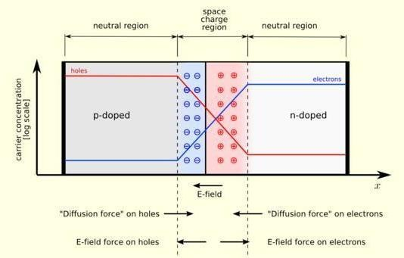
p-n junction in thermal equilibrium: with zero bias voltage applied
The regions nearby the p-n interfaces lose their neutrality and become charged, forming the
space charge region or depletion layer.

Slide 23
p-n junction in thermal equilibrium: with zero bias voltage applied
The electric field created by the space charge region opposes the diffusion process for both electrons and holes.
There are two concurrent phenomena: the diffusion process that tends to generate more space charge, and the electric field generated by the space charge that tends to counteract the diffusion.
The space charge region is a zone with a net charge provided by the fixed ions (donors or acceptors) that have been left uncovered by majority carrier diffusion.
When equilibrium is reached, the charge density is approximated by the displayed step function.
The region is completely depleted of majority carriers (leaving a charge density equal to the net doping level), and the edge between the space charge region and the neutral region is quite sharp.
The space charge region has the same charge on both sides of the p-n interfaces, thus it extends farther on the less doped side.

Slide 24
Forward and reverse current-zero bias
a few holes (majority carriers) in the P-type material with enough energy to overcome the potential barrier will move across the junction against this barrier potential. This is known as the “Forward Current” and is referenced as I_{F}
Holes generated in the N-type material (minority carriers), find this situation favourable and move across the junction in the opposite direction. This is known as the “Reverse Current” and is referenced as I_{R}. This transfer of electrons and holes back and forth across the PN junction is known as diffusion
N type electrons are getting diffused with p type holes, it forms donor ions at n side and acceptor ions at p side
Positive ions repel holes and negative ions repels electrons which forms barrier at the junction and prevents further flow of charge carriers
“Equilibrium” or balance will be established when the majority carriers are equal and both moving in opposite directions, so that the net result is zero current flowing in the circuit.
When this occurs the junction is said to be in a state of “Dynamic Equilibrium“

Slide 25
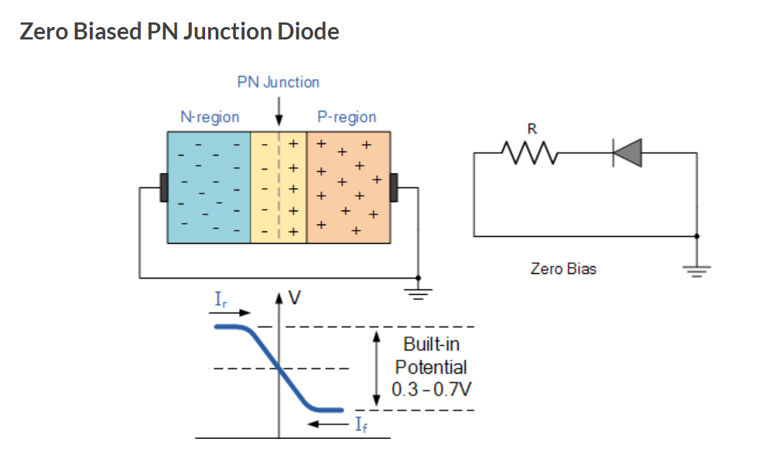

Slide 26

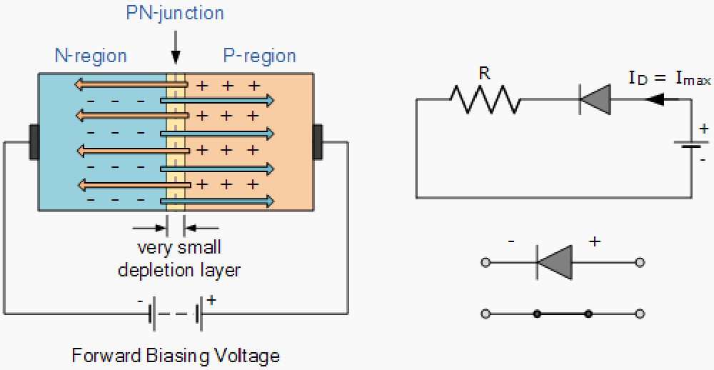
When a diode is connected in a Forward Bias condition, a negative voltage is applied to the N-type material and a positive voltage is applied to the P-type material. If this external voltage becomes greater than the value of the potential barrier, approx. 0.7 volts for silicon and 0.3 volts for germanium, the potential barriers opposition will be overcome and current will start to flow.
This is because the negative voltage pushes or repels electrons towards the junction giving them the energy to cross over and combine with the holes being pushed in the opposite direction towards the junction by the positive voltage

Slide 27
The applied forward potential establishes the electric field which acts against the field due to potential barrier. (The potential difference required for the electrons to be passed across the electric field)
Therefore, the resultant field is weakened and the barrier height is reduced at the junction.
Since the potential barrier voltage is very small, a small forward voltage is sufficient to completely eliminate the barrier.
Once the potential barrier is eliminated by the forward voltage, junction resistance becomes almost zero and a low resistance path is established for the entire circuit. Therefore, current flows in the circuit. This is called forward current.

Slide 28
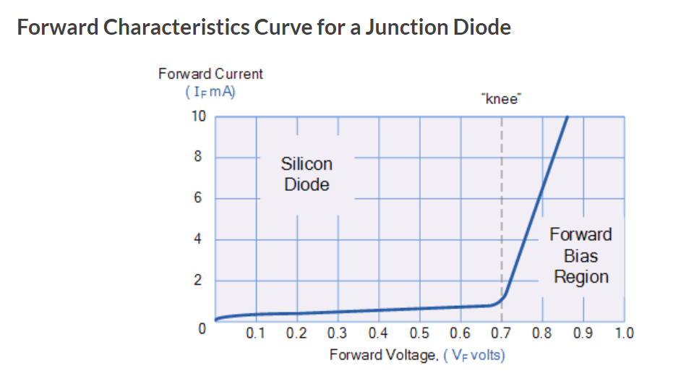

Slide 29
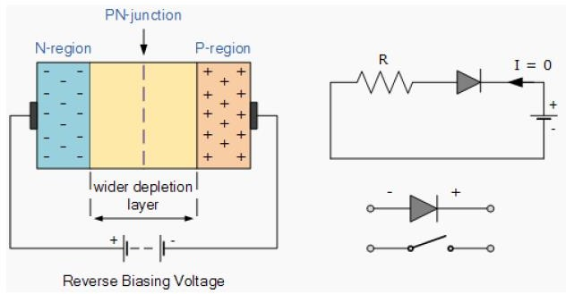
Reverse biasing of p-n junction
When a diode is connected in a Reverse Bias condition, a positive voltage is applied to the N-type material and a negative voltage is applied to the P-type material.
The positive voltage applied to the N-type material attracts electrons towards the positive electrode and away from the junction, while the holes in the P-type end are also attracted away from the junction towards the negative electrode.
The net result is that the depletion layer grows wider due to a lack of electrons and holes and presents a high impedance path, almost an insulator and a high potential barrier is created across the junction thus preventing current from flowing through the semiconductor material

Slide 30
The applied reverse voltage establishes an electric field which acts in the same direction as the field due to potential barrier. Therefore, the resultant field at the junction is strengthened and the barrier height is increased.
The increased potential barrier prevents the flow of charge carriers across the junction. Thus, a high resistance path is established for the entire circuit and hence current does not flow.

Slide 31
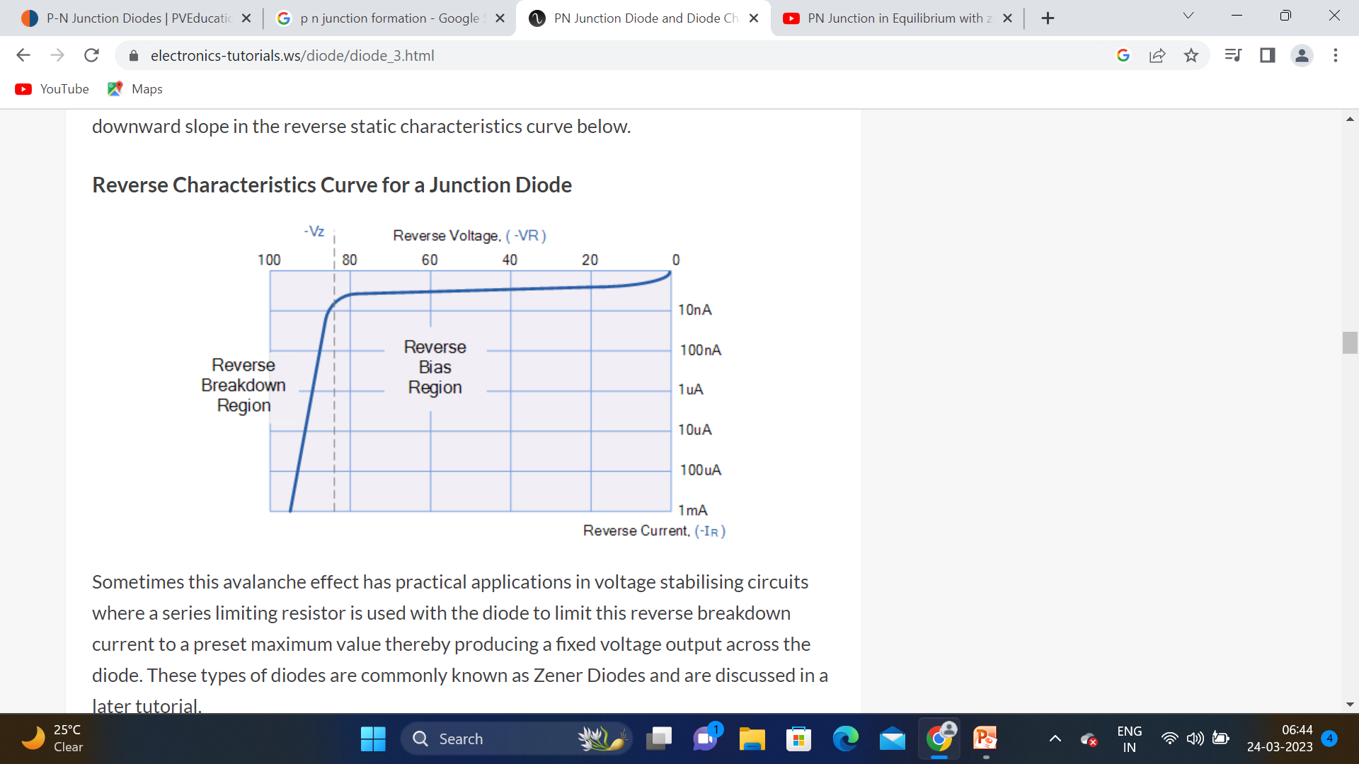
One final point, if the reverse bias voltage Vr applied to the diode is increased to a sufficiently high enough value, it will cause the diode’s PN junction to overheat and fail due to the avalanche effect around the junction.
This may cause the diode to become shorted and will result in the flow of maximum circuit current, and this shown as a step downward slope in the reverse static characteristics curve

Slide 32
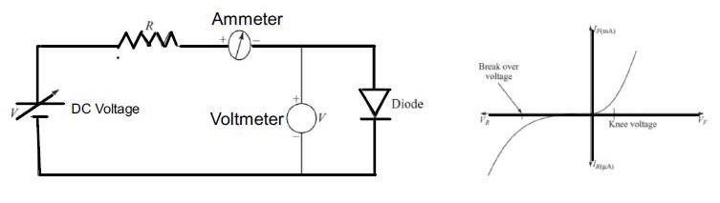
VOLT-AMPERE (V-I ) CHARACTERISTICS OF P-N
JUNCTION DIODE
The V-I characteristics of a semiconductor diode can be obtained with the help of the circuit
.
The supply voltage V is a regulated power supply, the diode is forward biased in the circuit shown. The resistor R is a current limiting resistor.
By varying the supply voltage different sets of voltage and currents are obtained.
By plotting these values on a graph, the forward characteristics can be obtained. It can be noted from the graph the current remains zero till the diode voltage attains the barrier potential.
For silicon diode, the barrier potential is 0.7 V and for germanium diode, it is 0.3 V. The barrier potential is also called knee voltage or cut-in voltage.
The reverse characteristics can be obtained by reverse biasing the diode.
It can be noted that at a particular reverse voltage, the reverse current increases rapidly. This voltage is called breakdown voltage.

Slide 33
Zero bias- no external voltage applied and this means that the potential barrier at the junction does not allow the flow of current
Forward bias-the current increases slowly, and the curve obtained is non-linear. As the voltage applied to the diode overcomes the potential barrier, diode behaves normally, and the curve rises sharply as the external voltage increases, and the curve obtained is linear.

Slide 34
Reverse bias-Increase in the potential barrier.
Reverse saturation current flows in the beginning as minority carriers are present in the junction.
When the applied voltage is increased, the minority charges will have increased kinetic energy which affects the majority charges-diode breaks down-destroy the diode.

Slide 35
DIODE CURRENT EQUATION
⎛
V_{D}
⎞
I_{D} is the total diode current
I_{s} reverse saturation current
- V_{D} applied voltage across the diode
- η an ideality factor, value between 1&2.
- V_{T} thermal voltage:
I_{D} = I_{s} ⎜ e
nV
−1⎟
⎠
T
⎝
where k = 1.38 x 10⁻²³ J/K , Boltzmann constant
q = 1.6x10⁻¹⁹ C , charge of electrons T= temperature in ºK
kT
VT =
q
At room temperature 27ºC , T= 273+27= 300ºK
Thermal Voltage V_{T} ≈ 26mV

Slide 36
(
DIODE CURRENT EQUATION
⎛ ⎞
V
e −1)= 0
V_{D} = 0,  I_{D} = I_{s} ⎜ e
D
nV
−1
⎟
= I
0
→ With Zero Voltage:
T
⎜
⎟
s
⎝
⎠
→ Under forward-biased condition, V_{D} > 0 So V_{D} >> ηV_{T}, then
V_{D}
V_{D}
_{e}nV_{T}
>> 1 and I_{D} ≅ I_{S} e^{nVT}
→ Under Reversed-biased Condition
V_{D}
_{e}nV_{T}
V_{D} < 0 So V_{D} << ηV_{T}, then
<< 1 and I_{D} ≅ −I_{S}

Slide 37
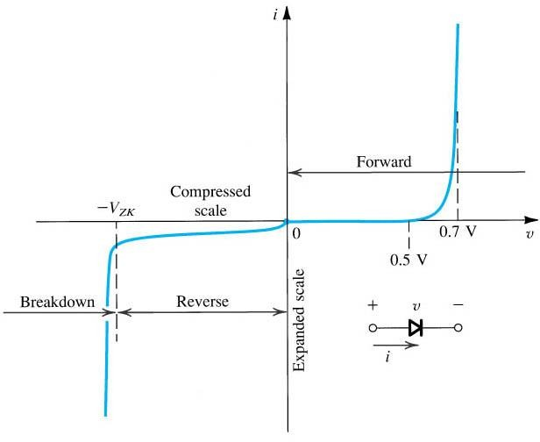
I-V Characteristics
⎛
V
⎞
I = I ⎜ e
D
nV
−1⎟
V_{D}
D s ⎜
T
⎟
I_{D} ≅ I_{S} e
nV
T
⎝
⎠
I_{D} ≅ −I_{S}
When V_{D} < V_{ZK}, the diode enters the breakdown region, the reverse current increases sharply. V_{ZK} is known as the zener knee voltage.

Slide 38
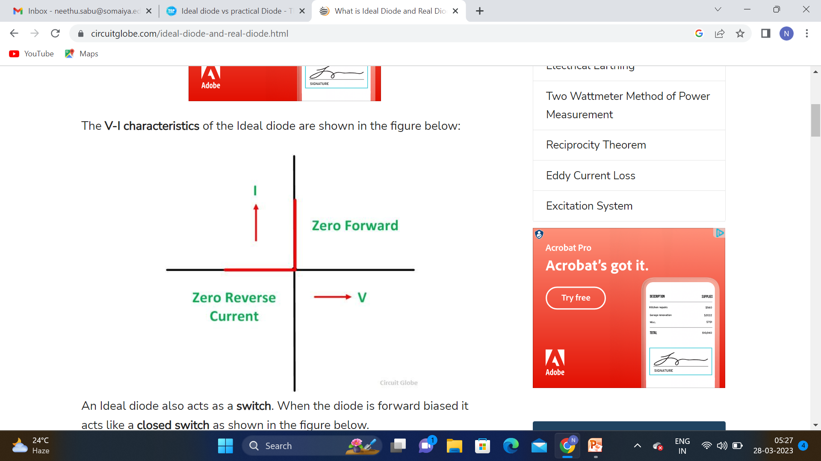
Ideal diode
diode is said to be an Ideal Diode when it is forward biased and acts as a perfect conductor, with zero voltage across it. Similarly, when the diode is reversed biased, it acts as a perfect insulator with zero current through it.

Slide 39
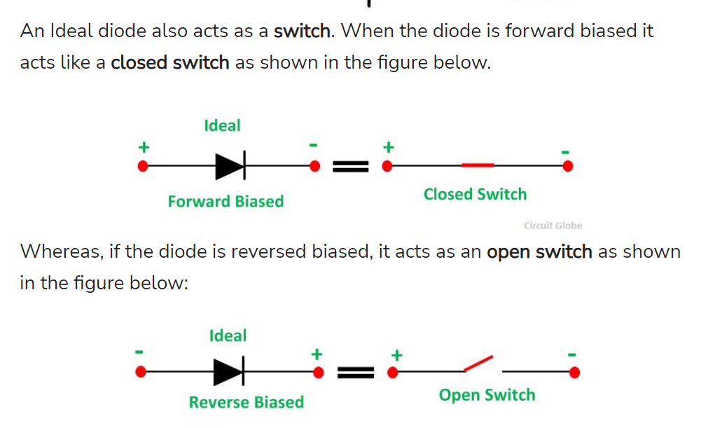

Slide 40
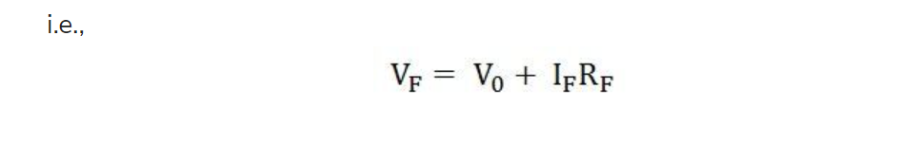
A Real diode contains barrier potential V₀ (0.7 V for silicon and 0.3 V for Germanium) and a forward resistance R_{F} of about 25 ohms.
When a diode is forward biased and conducts a forward current I_{F} flows through it which causes a voltage drop I_{F}R_{F} in the forward resistance.
Hence, the forward voltage V_{F} applied across the real diode for conduction, has to overcome the following.
Potential barrier
Drop in forward resistance

Slide 41
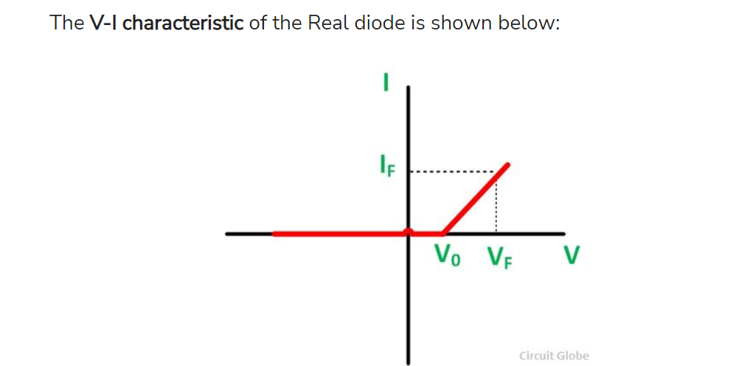

Slide 42
Basic Definitions
Knee Voltage or Cut-in Voltage
It is the forward voltage at which the diode starts conducting.
Breakdown Voltage
It is the reverse voltage at which the diode (p-n junction) breaks down with a sudden rise in reverse current.
Peak-inverse Voltage (PIV)
It is the maximum reverse voltage that can be applied to a p-n junction without causing damage to the junction. If the reverse voltage across the junction exceeds its peak inverse voltage, then the junction exceeds its peak-inverse voltage, and the junction gets destroyed because of excessive heat.

Slide 43
Basic Definitions
Maximum Forward Current
It is the maximum instantaneous forward current that a p-n junction can conduct without damaging the junction. If the forward current is more than the specified rating then the junction gets destroyed due to overheating.
Maximum Power Rating
It is the maximum power that can be dissipated at the junction without damaging it.The power dissipated across the junction is equal to the product of junction current and the voltage across the junction.
.

Slide 44
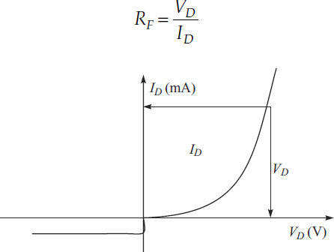
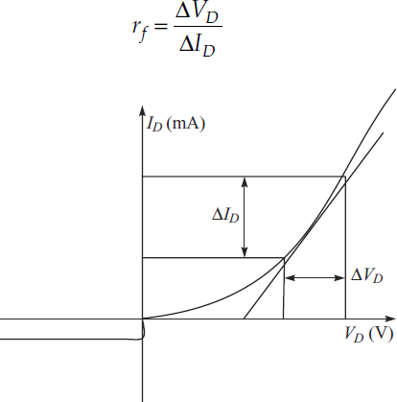
STATIC AND DYNAMIC RESISTANCE OF A DIODE
DC or Static Resistance
When diode is forward biased, it offers a definite resistance in the circuit. This resistance is known as dc resistance or static resistance (RF). It is simply the ratio of the dc voltage (VD) across the diode to the dc current (ID) flowing through it.
AC or Dynamic Resistance
The ac or dynamic resistance of a diode, at a particular dc voltage, is equal to the reciprocal of the slope of the characteristics at that point

Slide 45
BREAK DOWN Mechanisms In PN Junction
Reverse bias voltage, at which the breakdown of a P-N junction diode occurs is called the breakdown voltage.
The breakdown voltage depends on the width of the depletion region, which, in turn, depends on the doping level.
There are two mechanisms by which breakdown can occur at a reverse biased P-N
junction
avalanche break down
Zener breakdown.

Slide 46
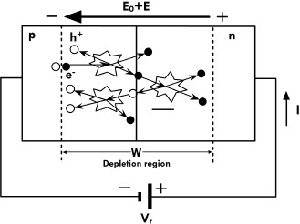
Avalanche breakdown
Avalanche breakdown occurs in moderately and lightly doped PN junctions with a wide depletion region.
Electron hole pairs thermally generated in the depletion region are accelerated by the external reverse bias. Electrons are accelerated towards the n side and holes towards the p side.
These electron can interact with other Si atoms and if they have sufficient energy can knock out electrons from these Si atoms. This process is called impact ionization and leads to production of a large number of electrons.
This causes the rapid rise in current. The breakdown voltage decreases with increase in dopant concentration.
The breakdown region is the knee of the characteristic curve. After breakdown the current is not controlled by the junction voltage but rather by the external circuit.

Slide 47
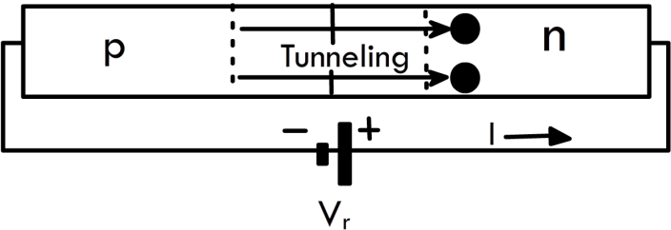
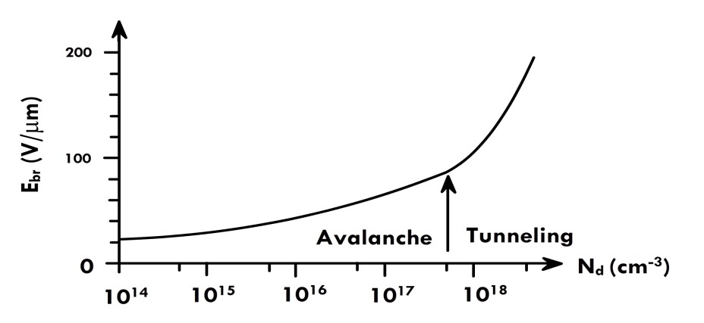
Zener breakdown
With increase in doping concentration the breakdown mechanism, changes from Avalanche to a tunnelling mechanism. This is called a Zener breakdown.
The depletion width decreases with dopant concentration.
It is possible for carriers to tunnel across the narrow depletion region.
The electrons tunnel from the valence band on the p side to the conduction band on the n side, driven by the externally applied reverse bias. Tunnelling also leads to a large increase in current.
The transition from avalanche to Zener as the primary breakdown mechanism with dopant concentration is shown.
.

Slide 48
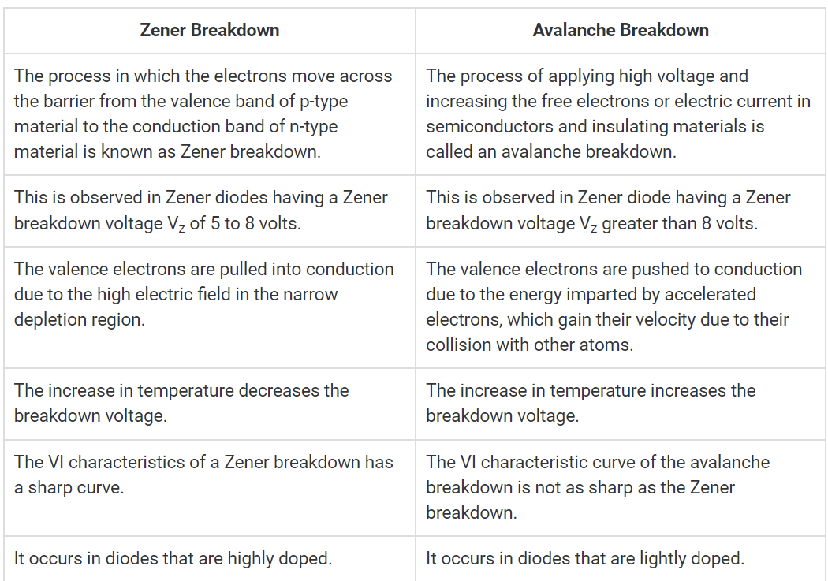

Slide 49
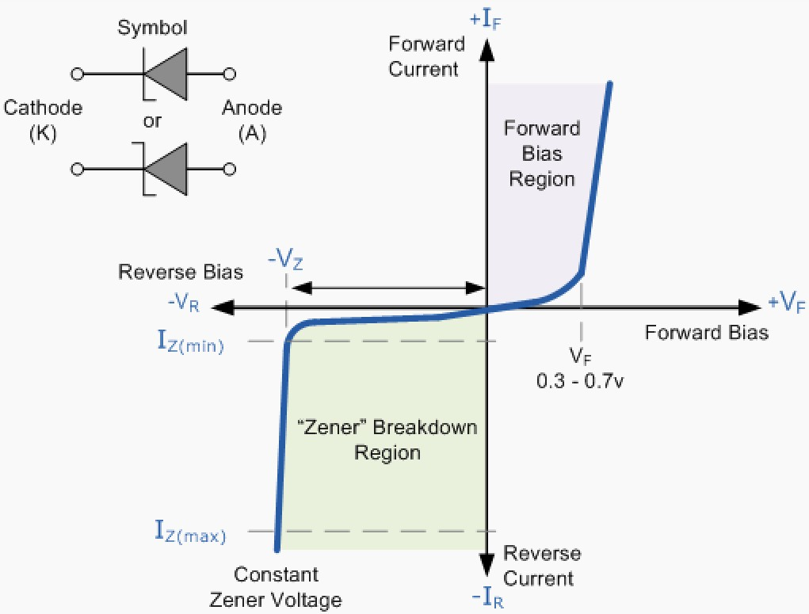
Zener Diode
The Zener diode is like a general-purpose signal diode consisting of a silicon PN junction.
When biased in the forward direction it behaves just like a normal signal diode passing the rated current.
A reverse voltage applied across the Zener diode exceeds the rated voltage of the device, the diodes breakdown and high current flows through diode.
Zener diodes are primarily used as surge protectors ( to protect electronic equipment from unwanted power surges) in circuits, since there is a rapid increase in current with a small change in voltage.
Prior to breakdown there is a high resistance small reverse saturation current but after breakdown the resistance is very small.
Zener diode is used as voltage regulators in circuits.

Slide 50
V-I characteristics of Zener diode
As soon as the reverse voltage reaches a pre-determined value, the zener diode begins to conduct in the reverse direction.
they have a fixed breakdown voltage, V_{Z} value which is determined during manufacture.
Once the reverse voltage applied across the zener diode exceeds the rated voltage of the device, a process called Zener Breakdown occurs in the semiconductor depletion layer and a current starts to flow through the diode to limit this increase in voltage.
The current now flowing through the zener diode increases dramatically to its maximum circuit value (which is usually limited by a series resistor).
Once zener breakdown occurs, the voltage drop across the diode remains fairly constant even though the zener current, I_{Z} through it can vary considerably.
The voltage point at which the voltage across the zener diode becomes stable is called the “zener voltage”, (V_{Z}).

Slide 51
From the I-V characteristics curve, zener diode has a region in its reverse bias characteristics of almost a constant negative voltage regardless of the value of the current flowing through the diode.
This voltage remains almost constant even with large changes in current providing the zener diodes current remains between the breakdown current I_{Z(min)} and its maximum current rating I_{Z(max)}.
This ability of the zener diode to control itself can be used to great effect to regulate or stabilise a voltage source against supply or load variations.
The fact that the voltage across the diode in the breakdown region is almost constant turns out to be an important characteristic of the zener diode as it can be used in the simplest types of voltage regulator applications.
A zener diode will continue to regulate its voltage until the diodes holding current falls below the minimum I_{Z(min)} value in the reverse breakdown region.

Slide 52
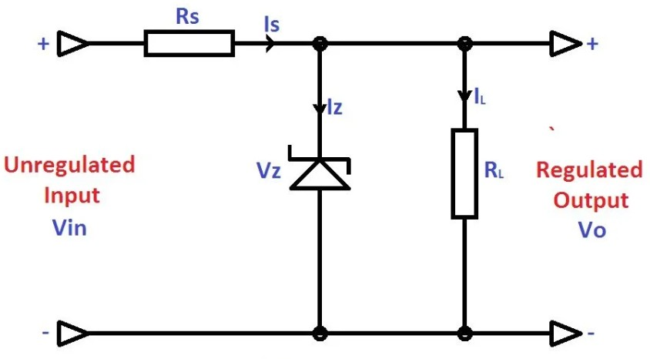
Zener Diode as Voltage Regulator
Zener Diodes are widely used as Shunt Voltage
Regulators to regulate voltage across small loads.
The zener voltage regulator consists of a current limiting resistor R_{S} connected in series with the input voltage V_{S} with the zener diode connected in parallel with the load R_{L} in this reverse biased condition.
Zener Diodes have a sharp reverse breakdown voltage and breakdown voltage will be constant for a wide range of currents.
Thus Zener diode parallel to the load such that the applied voltage will reverse bias it.
If the reverse bias voltage across the Zener diode exceeds the knee voltage, the voltage across the load will be constant.
excess voltage (Vin – Vz) will drop across Rs thus by limiting the current through Zener

Slide 53
The value of Rs must be small enough to keep the Zener Diode in reverse breakdown region.
The minimum current required for a Zener Diode to keep it in reverse breakdown region will be given in its datasheet.
For example, a 5.6 V, 0.5 W Zener diode has a recommended reverse current of 5 mA. If the reverse current is less than this value, the output voltage Vo will be unregulated.
The value of Rs must be large enough that the current through the zener diode should not destroy it.
That is the maximum power dissipation Pmax should be less than IzVz.
we should find R_{s}min and R_{s}max.
To find the value of R_{s}min consider the extreme condition that Vin is minimum and load current is maximum.

Slide 54
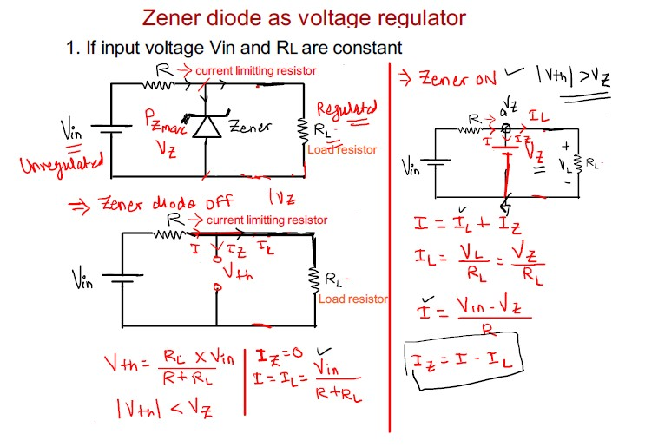
Zener Diode as Voltage Regulator

Slide 55
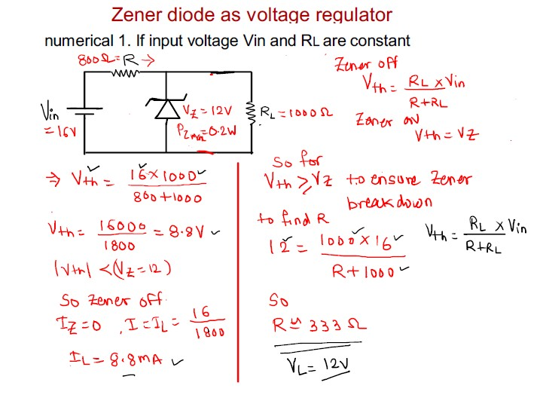
Zener Diode as Voltage Regulator..

Slide 56
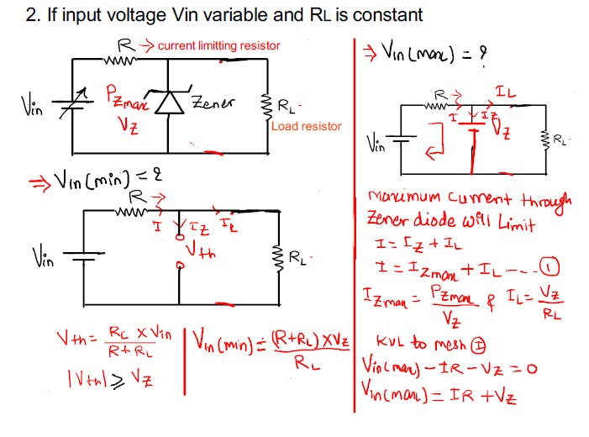
Zener Diode as Voltage Regulator..

Slide 57
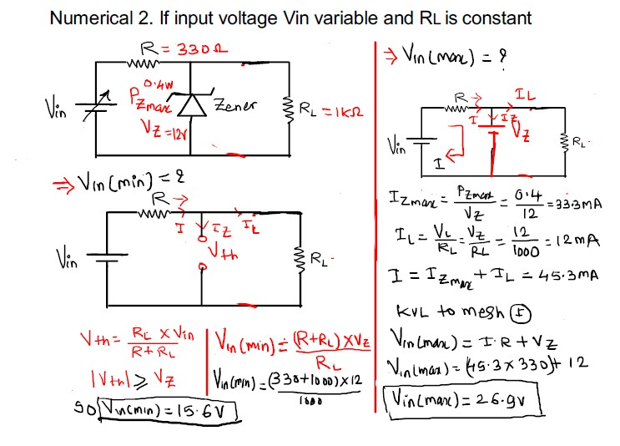
Zener Diode as Voltage Regulator..

Slide 58
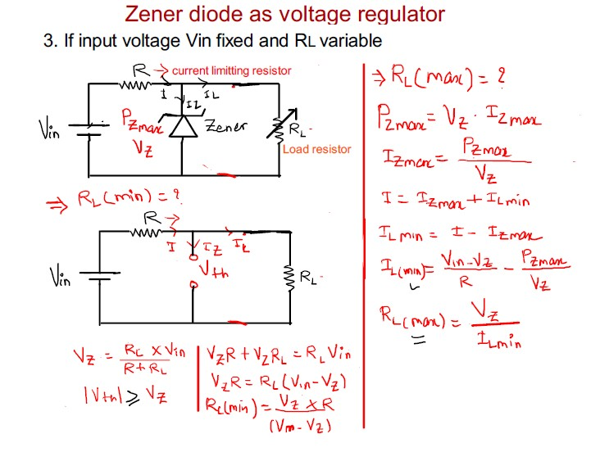

Slide 59
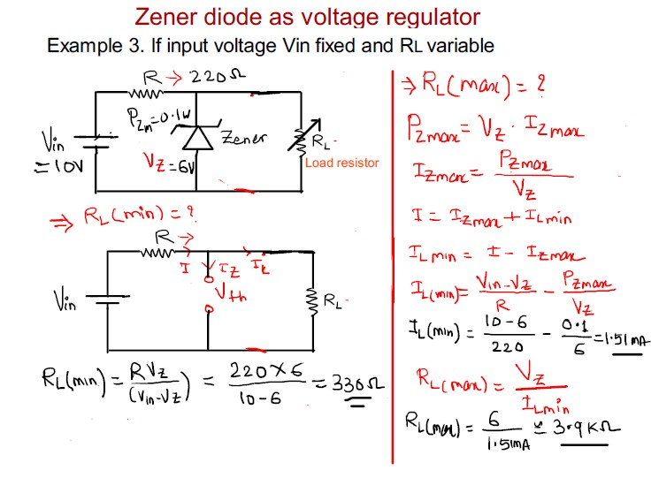

Slide 60
Rectifiers
Power Diodes are semiconductor pn-junctions capable of passing large currents at high voltage values for use in rectifier circuits.
One widely used application of this feature and the power diode in general is in the conversion of an alternating voltage (AC) into a pulsating voltage (DC)-Rectification.
A simple PN junction diode acts as a rectifier. The forward biasing and reverse biasing conditions of the diode makes the rectification.
A halfwave rectifier is defined as a type of rectifier that allows only one-half cycle of an AC input voltage waveform to pass while blocking the other half cycle.
Full-wave rectifier circuit rectifies both positive and negative half cycles of the input supply.

Slide 61
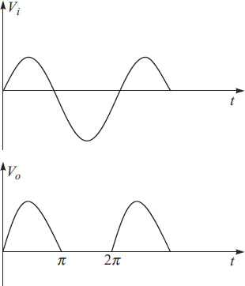
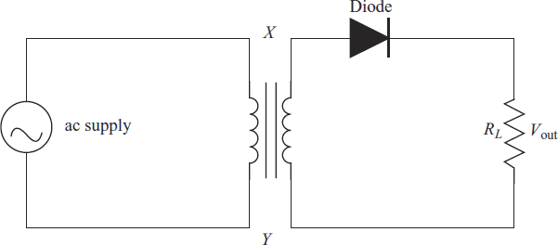
HALF-WAVE RECTIFIER
The circuit diagram of a half-wave rectifier is shown along with the I/P and O/P Waveforms.
The transformer is employed in order to step-down the supply voltage.
The diode is used to rectify the ac signal while the pulsating dc is taken across the load resistor RL.
During the +ve half-cycle, the end X of the secondary is +ve and end Y is –ve. Thus, forward biasing the diode. As the diode is forward biased, the current flows through the load RL and a voltage is developed across it.
During the –ve half-cycle the end Y is +ve and end X is –ve thus, reverse biasing the diode. As the diode is reverse biased there is no flow of current through RL thereby the output voltage is zero.
5.1 Diode and Rectifiers EEEE-MBZ/KJSCE

Slide 62
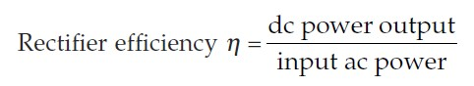
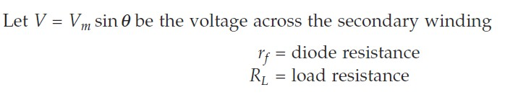
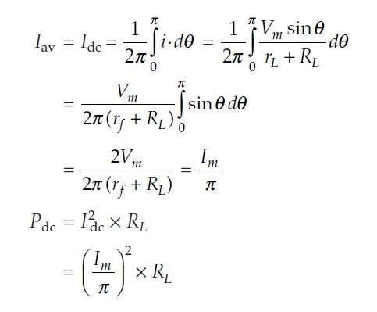
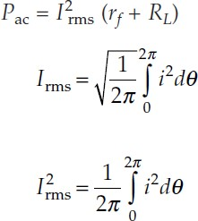
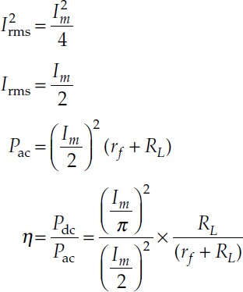
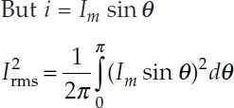
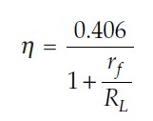
Efficiency of a Half wave Rectifier
dc Power
ac Power Input
The efficiency is maximum if rf is negligible as compared to RL.
Therefore, maximum rectifier efficiency = 40.6%

Slide 63
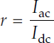
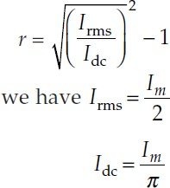
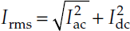
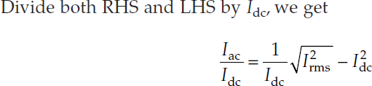
Ripple Factor
The pulsating output of a rectifier consists of dc component and ac component (also known as ripple). The ac component is undesirable and accounts for the pulsations in the rectifier output. The effectiveness of a rectifier depends on the magnitude of ac component in the output : the smaller this component, the more effective is the rectifier. “ The ratio of rms value of ac component to the dc component in the rectifier output is known as ripple factor”.
Ripple Factor for Half-wave Rectification
OR 𝑰_{𝒂𝒄} =
^{𝑰𝟐}𝒓𝒎𝒔 ^{− 𝑰𝟐}𝒅𝒄
It is clear that ac component exceeds dc component in the output of a half-wave rectifier.

Slide 64

Transformer utilization factor
Transformer utilization factor is a quantitative indication of the utilization of VA Rating of Transformer. The more the value of TUF, the more will be the utilization. In other words, the VA rating of required transformer will be less if TUF is more and vice versa.
The D.C. power to be delivered to the load, in a rectifier circuit decides the rating of the transformer used in a circuit.
DC Power Output, Pdc = Average Current x Average Voltage

Slide 65
Transformer Utilization Factor (TUF) of Half Wave Rectifier
DC Power Output, Pdc = Average Current x Average Voltage
𝑽_{𝒎} 𝑰_{𝒎}
𝑷 = 𝑿
…………………(1)
𝒅𝒄
𝝅 𝝅
VA rating of Transformer
The voltage of source is sinusoidal, therefore its rms value will be equal to (Vm/√2).
The rms value of the source current will be equal to the rms value of the load current. As the rms value of load current for half wave rectifier is equal to (Im/2), therefore the rms value of source current will also be equal to (Im/2).
_{𝑽𝑨} 𝑽_{𝒎} 𝑰_{𝒎}
𝒓𝒂𝒕𝒊𝒏𝒈 ^{= 𝑿}
√𝟐 𝟐
…………………(2)
From equation (1) and (2)
𝑻𝑼𝑭 = ^{𝟐√𝟐}
_{π𝟐} = 0.285
5.1 Diode and Rectifiers EEEE-MBZ/KJSCE

Slide 66

Peak Inverse Voltage
The maximum inverse voltage that the diode can withstand without being destroyed is called as Peak Inverse Voltage.
During Negative Half cycle Diode D is Reverse biased shown by open circuit so Voltage across is Vm.
VDmax=-Vm
So PIV= Vm

Slide 67
Full wave rectifier
Full Wave Rectifier is a diode circuit which is used to transform the complete cycle of Alternating Voltage (AC Supply) to Direct Voltage (DC Supply).
In full wave rectification, current flows through the load in the same direction for the complete cycle of input AC Supply.

Slide 68

FULL-WAVE RECTIFIER
Full-wave rectifiers are of two types:
1. Centre tapped full-wave rectifier 2. Bridge rectifier
Centre Tapped Full-wave Rectifier
It employs two diodes and a centre tap transformer.,RL The ac signal to be rectified is applied to the primary of the transformer and the dc output is taken across the load, RL.
During the +ve half-cycle end X is +ve and end Y is –ve. This makes diode D1 forward biased and thus a current i1 flows through it and load resistor RL. Diode D2 is reverse biased and the current i2 is zero.
During the –ve half-cycle end Y is +ve and end X is –ve. Now diode D2 is forward biased and thus a current i2 flows through it and load resistor RL. Diode D1 is reversed and the
current i1 = 0.
Disadvantages
Since each diode uses only one-half
of the transformer secondary voltage the dc output is comparatively small.
It is difficult to locate the centre- tap on secondary winding of the transformer.
The diodes used must have high
peak-inverse voltage
I₁
I₁

Slide 69

Peak Inverse Voltage
D
D
uring Positive half cycle D1 conducts (Short circuit) and 2 off (open circuit) so V_{D2max}= 2Vm
Vm
Vm
During negative half cycle D2 conducts (Short circuit) and D1 off (open circuit) so V_{D1max}= 2Vm
Vm
Vm
So PIV= 2Vm

Slide 70


Full-wave Bridge Rectifier
It uses four diodes and one transformer.
During the +ve half-cycle, end A is +ve and end B is –ve thus diodes D1 and D3 are forward bias while diodes D2 and D4 are reverse biased thus a current flows through diode D1, load RL (C to D) and diode D3.
During the –ve half-cycle, end B is +ve and end A is –ve thus diodes D2 and D4 are forward biased while the diodes D1 and D3 are reverse biased. Now the flow of current is through diode D4 load RL (D to C) and diode D2. Thus, the waveform is same as in the case of centre-tapped full-wave rectifier.
Advantages
The need for centre-tapped transformer is eliminated.
The output is twice when compared to centre-tapped full-wave rectifier, for the same secondary voltage.
The peak inverse voltage is one-half (1/2) compared to centre-tapped full-wave rectifier.
Can be used where large amount of power is required.
Disadvantages: • It requires four diodes. • The use of two extra diodes causes an additional voltage drop thereby reducing the output voltage.

Slide 71


Peak Inverse Voltage
During the +ve half-cycle, end A is +ve and end B is –ve thus diodes D1 and D3 are forward bias (Short circuit ) while diodes D2 and D4 are reverse biased (open circuit)
Vm
During the -ve half-cycle, end B is +ve and end A is –ve thus diodes D2 and D4 are forward bias (Short circuit ) while diodes D1 and D3 are reverse biased (open circuit)
Vm
So PIV= Vm

Slide 72





Efficiency of Full-wave Rectifier
ac power output
dc power output
The efficiency will be maximum if rf is negligible as compared to RL. Hence, maximum efficiency = 81.2%. This is double the efficiency due to half-wave rectifier. Therefore, a full-wave rectifier is twice as effective as a half-wave rectifier.

Slide 73



Ripple Factor for Full-wave Rectification

Slide 74

Comparison of Rectifiers
8. TUF | 0.285 | 0.672 | 0.810
https://electricalbaba.com/transformer-utilization-factor/
Check TUF of FWR in scan copy

Slide 75

FILTERS
The output of the rectifier is pulsating dc, i.e., the output obtained by the rectifier is not pure dc but it contains some ac components along with the dc o/p. These ac components are called ripples (ac components), which are undesirable or unwanted.
To minimize the ripples in the rectifier output filter circuits are used. These circuits are normally connected between the rectifier and load
Filter is a circuit which converts pulsating dc output from a rectifier to a steady dc output. In other words, filters are used to reduce the amplitudes of the unwanted ac components in the rectifier.
Types of Filters
1. Capacitor filter (C-filter) 2. Inductor filter
3. Choke input filter (LC-filter) 4. Capacitor input filter ( Π filter)
5.1 Diode and Rectifiers EEEE-MBZ/KJSCE

Slide 76


Capacitor Filter( C -Filter)
When the input signal rises from o to a the diode is forward biased therefore it starts conducting since the capacitor acts as a short circuit for ac signal. It gets charged up to the peak of the input signal and the dc component flows through the load, RL.
When the input signal falls from a to b the diode gets reverse biased. This is mainly because of the voltage across the capacitor obtained during the period o to a is more when compared to Vi. Therefore, there is no conduction of current through the diode.
The charged capacitor acts as a battery and it starts discharging through the load, RL. Meanwhile the
input signal passes through b, c, d sections. When the signal reaches the point d the diode is still reverse biased since the capacitor voltage is more than the input voltage. At e the input voltage can be expected to be more than the capacitor voltage. When the input signal moves from e to f the capacitor gets charged to its peak value again. The diode gets reverse biased and the capacitor starts discharging.
5.1 Diode and Rectifiers EEEE-MBZ/KJSCE

Slide 77

Ripple factor for the rectifiers with C-filter

